Slide 1
PROJECT TITLE:
Project Guide:
SHOPEZY
Murugeswari Mam

Slide 2
Group Members
Jatin Singh
Ashish Jose
Himanshi Panwar
Akshay Mathew
Shubh Shubhankar
20BCE10019
20BCE10286
20BCE10247
20BCE10237
20BCE11025

Slide 3
INTRODUCTION
ShopEzy is an application which will help to boost local businesses around our homes.

Slide 4
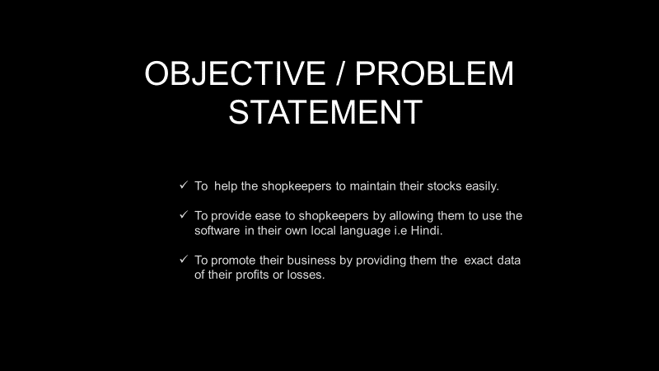

Slide 5
Limitation
01
Cannot receive online orders.
02
The app will be built in electron js so its performance might get affected as it uses chrome v8 engine on some low end devices.

Slide 6
Proposed Work and Methodology:
Our first approach towards the project would be making a figma design of both the desktop screen application and the mobile application.
Then with the help of html /css/javascript we will make the complete front end of the desktop application.
Then we will use the softwares such as Electron js/node js to make our frontend design functional as a desktop application.

Slide 7
Proposed Work and Methodology:
In addition we will use a software naming P5js for showing the analytic graphs and visualisations of product statistics .
Now for the mobile scanning application we will be using android studio and its special features such as Google machine learning api.
Now talking about sharing of data between mobile and desktop application ,so for this we will create a http server with the help of node js software and with the help of this software and internet connection we can connect our desktop server app with the client mobile application.

Slide 8
Real-Time Usage​
Automates Invoice production.​
Manages the stock.​
Checks the availability of Items.​
Gives the analysis of profit/loss of each products.​
Estimates Sales per month.​

Slide 9
Novelty of the Project
Multilingual(English/Hindi) support for Local level Market.​
Easy to maintain the stocks.​
Provides the better analysis of sales for each products.​
Invoice, the smart way.​
Minimize the Losses of Store.​
Easy accessible by any Android phone. No extra device needed. ​

Slide 10
Hardware :​
A laptop/desktop with a windows/linux architecture : With the help of desktop screen we will show all the data and information related to the project to the shopkeeper.​

Slide 11
An android phone:​
We will build an android application and install it in an android phone which will scan the barcode of the products available in the shop of the shopkeeper.​

Slide 12
Softwares:​
Figma : In this software we will perform UX/UI and prototype designing of our desktop application as well as our android application.​

Slide 13
JAVASCRIPT
ELECTRON JS
We will use this programming language to do all our programming works related to our desktop application.
We will use this software to make our designed frontend functional as a desktop software.

Slide 14
NODE JS:
This software will be used to support electron js with few of its special features.
Moreover we will make a http server with the help of Node Js to connect our desktop server application with our client mobile application

Slide 15
P5 JS:
ANDROID STUDIO:
We will use this software for making graphs and visualisations
We will use this software to develop our android mobile application.
The app will use google machine learning api which is available in this software for barcode scanning.

Slide 16
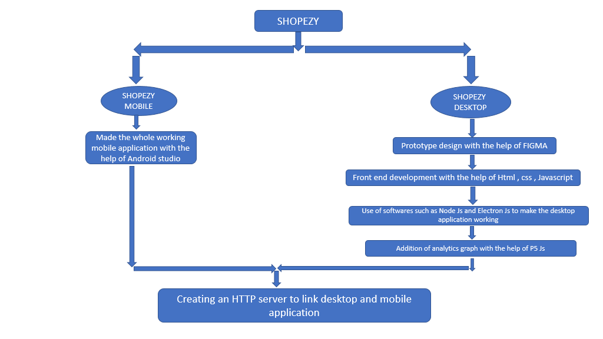
Module Workflow Explanation

Slide 17
Complete Module Split up with the help of
Circle Diagram:
04
Design
Performance Improvement
01
03
Development
Feedback from Clients
02

Slide 18
Objective :
To help the shopkeepers to maintain their stocks easily.
To provide ease to shopkeepers by allowing them to use the software in their own local language i.e Hindi.
To promote their business by providing them the exact data of their profits or losses.

Slide 19
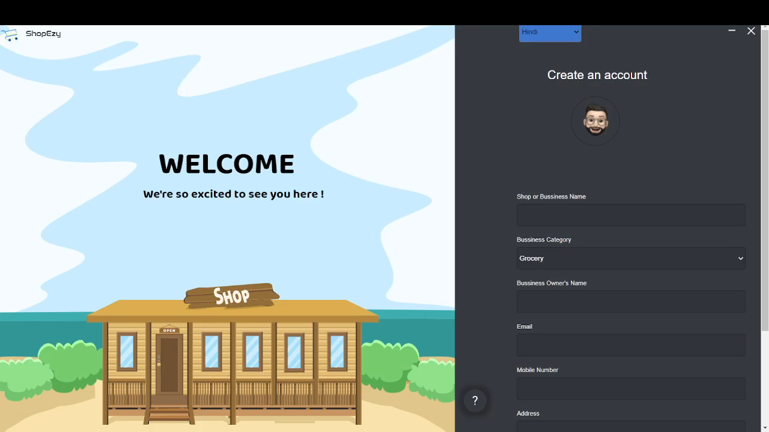
Demo Video

Slide 20
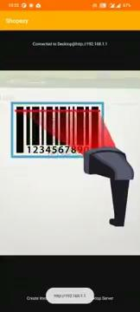
Demo Video

Slide 21
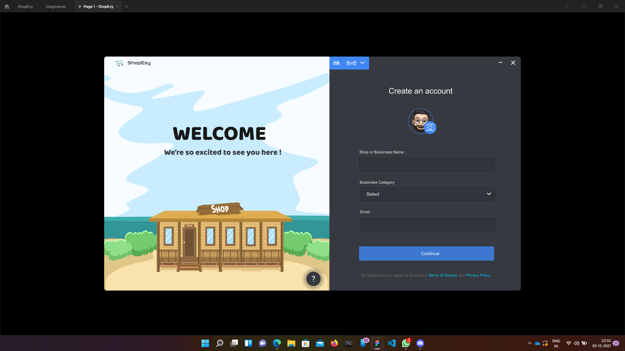

Slide 22
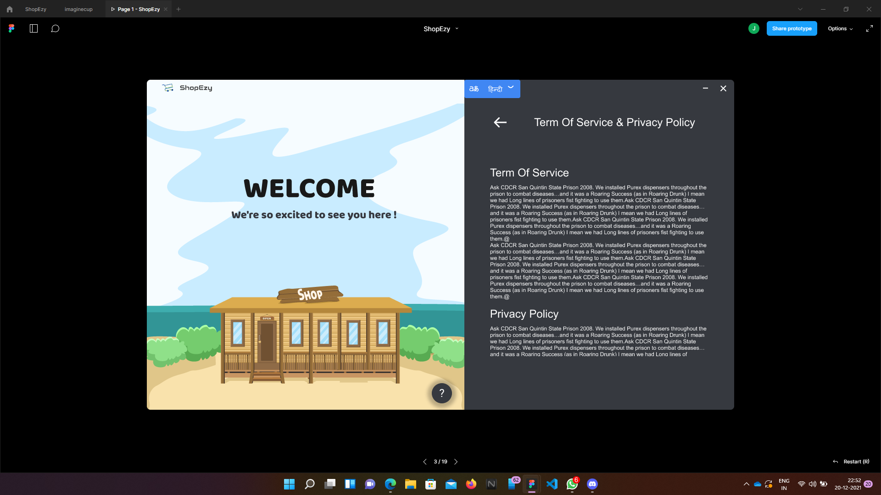

Slide 23
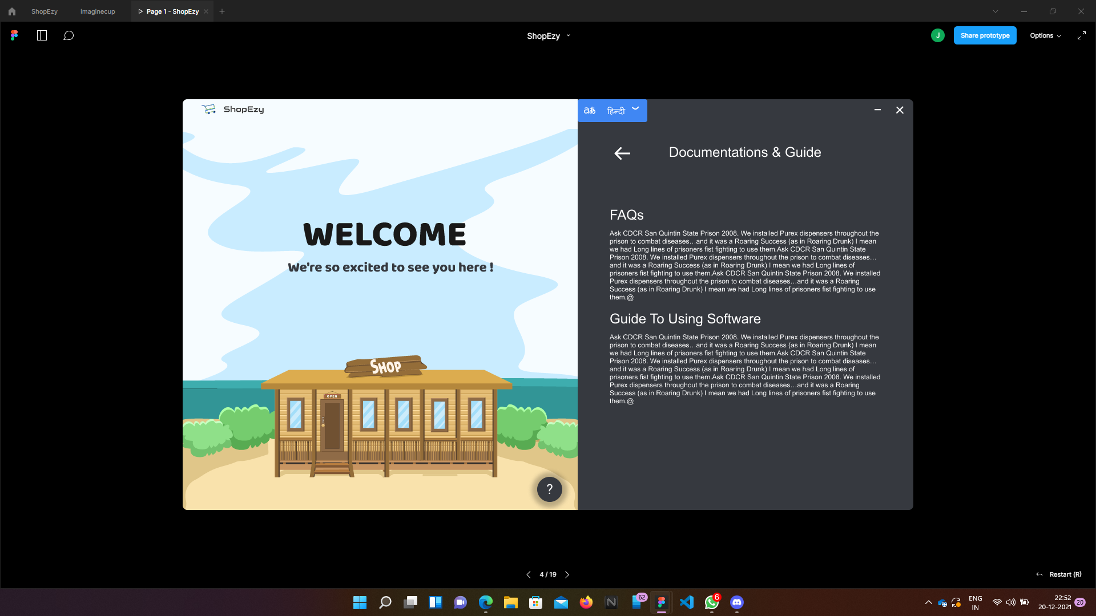

Slide 24
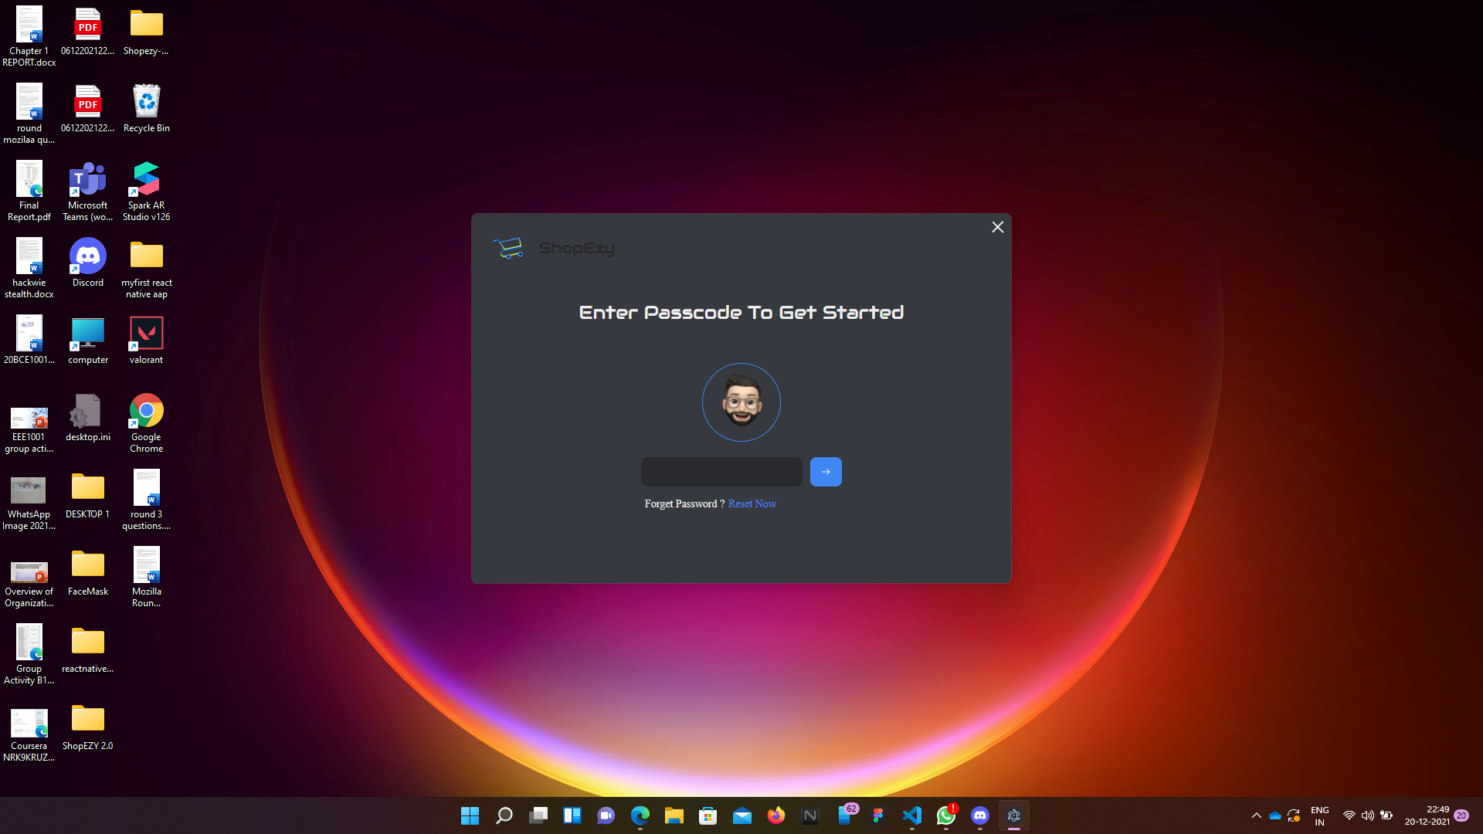

Slide 25
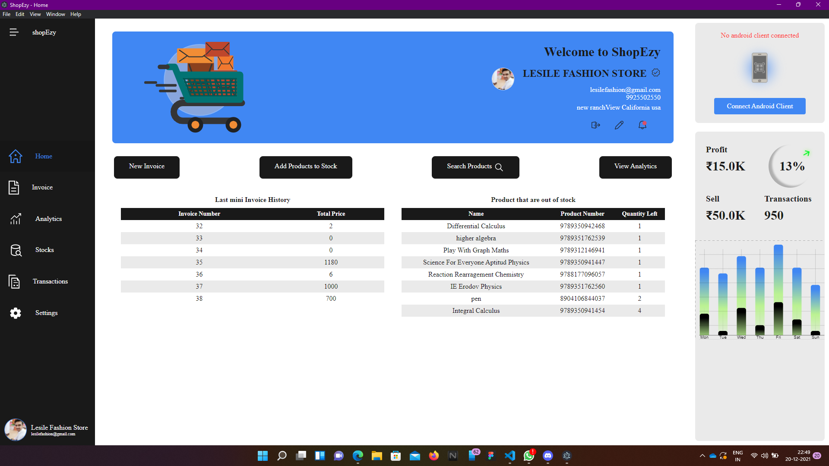

Slide 26
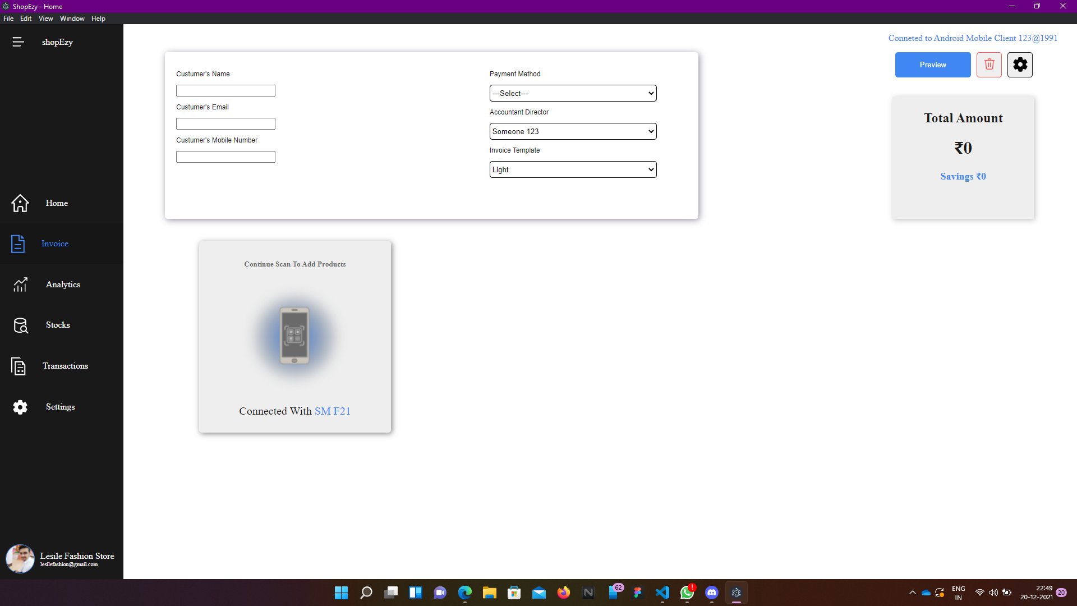

Slide 27
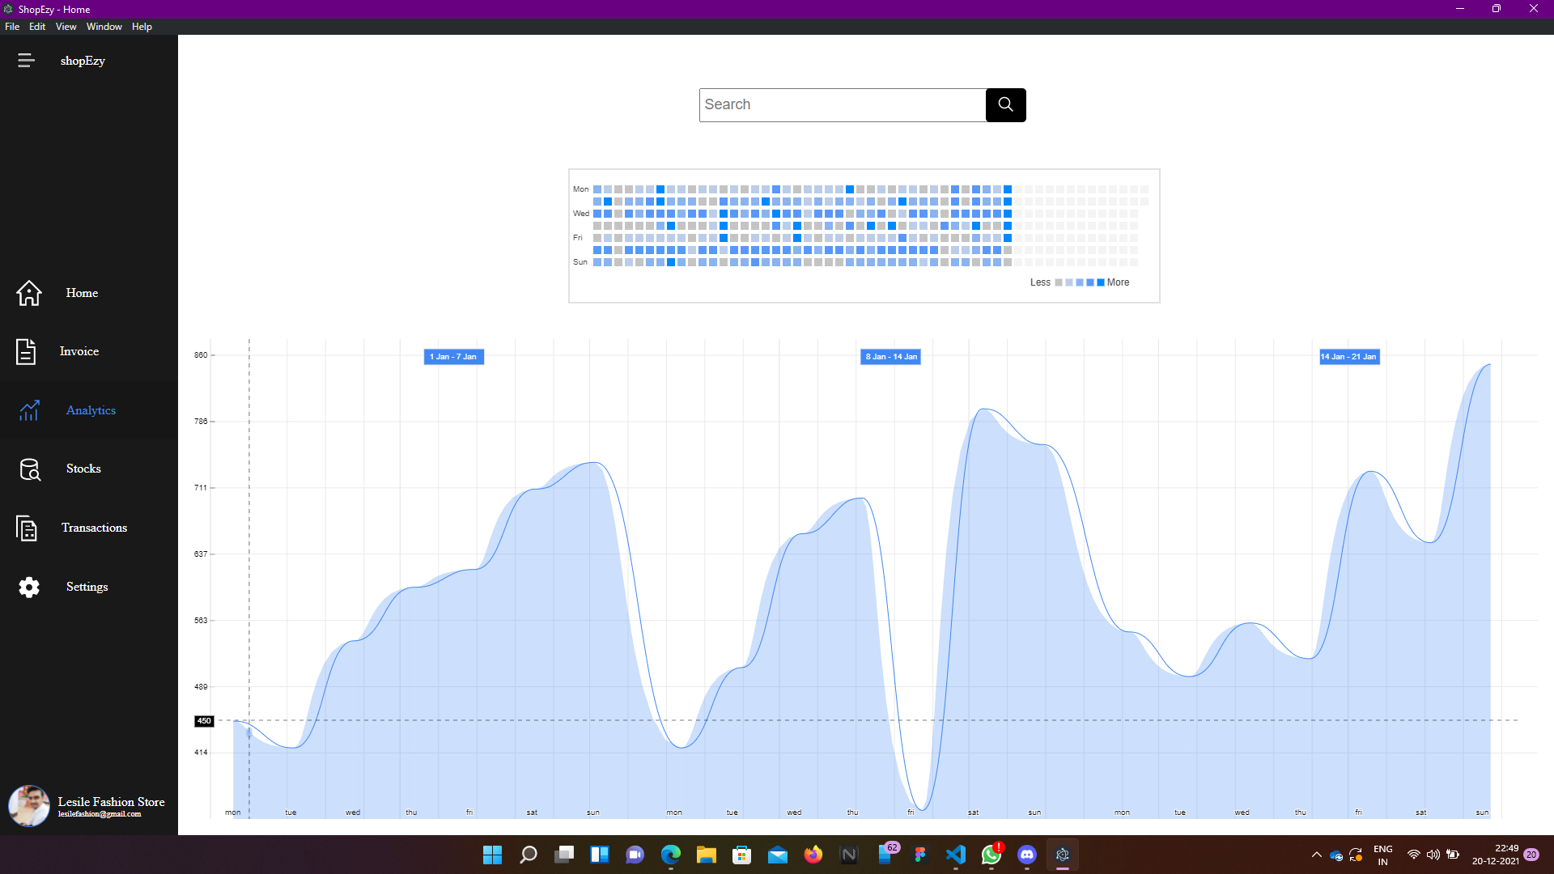

Slide 28
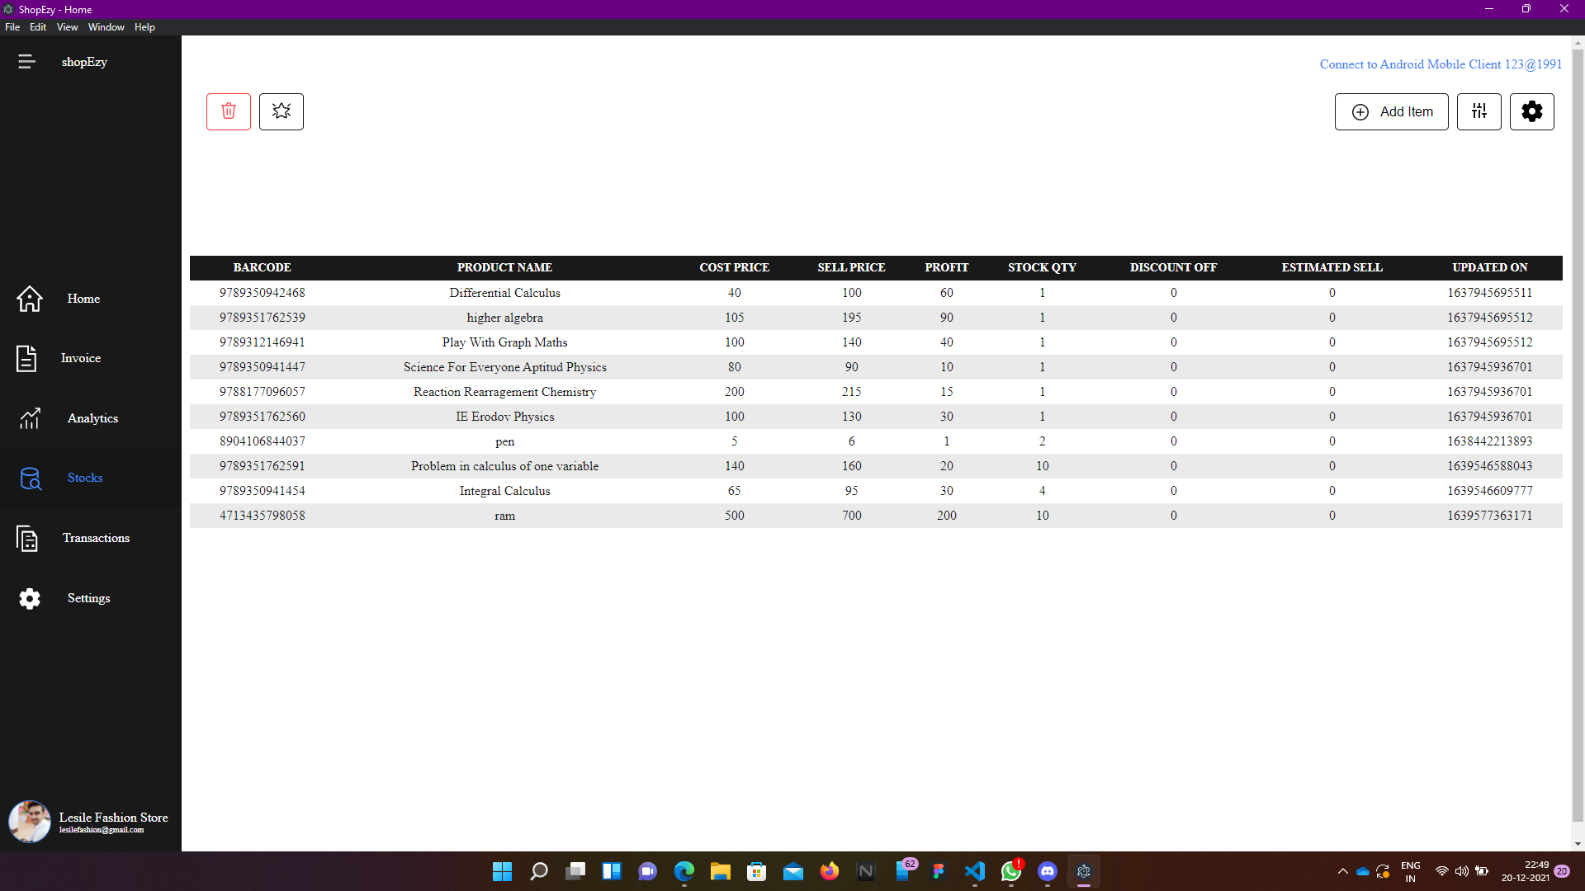

Slide 29
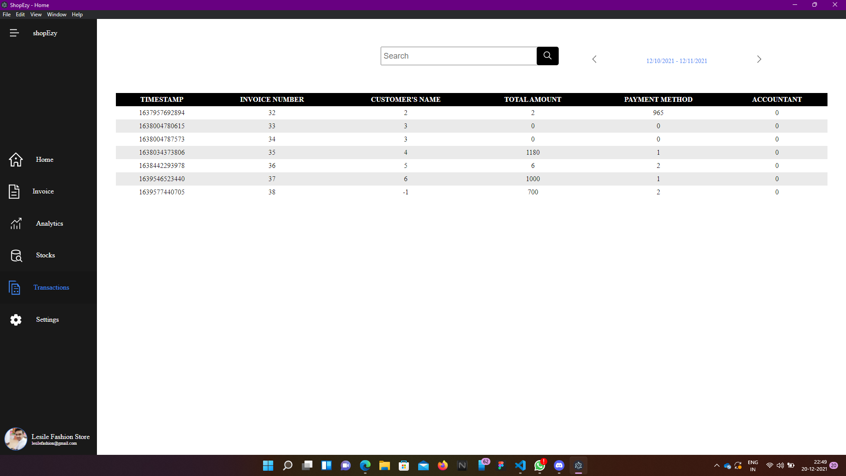

Slide 30
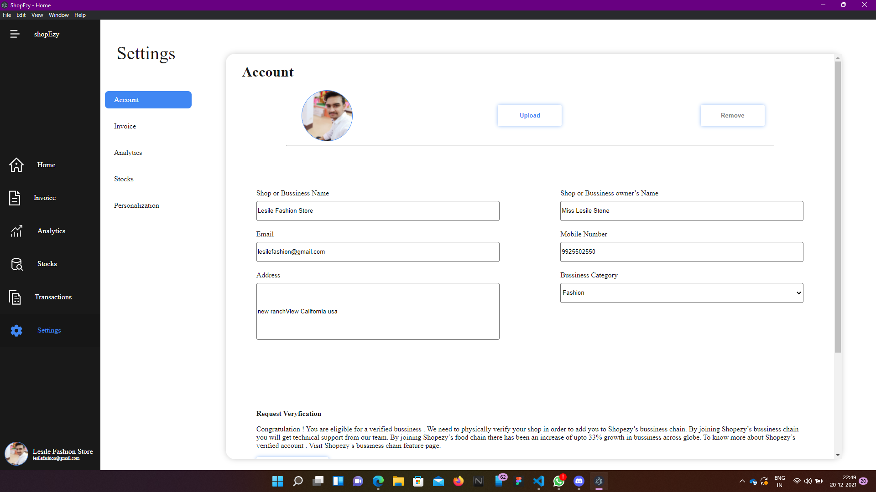

Slide 31
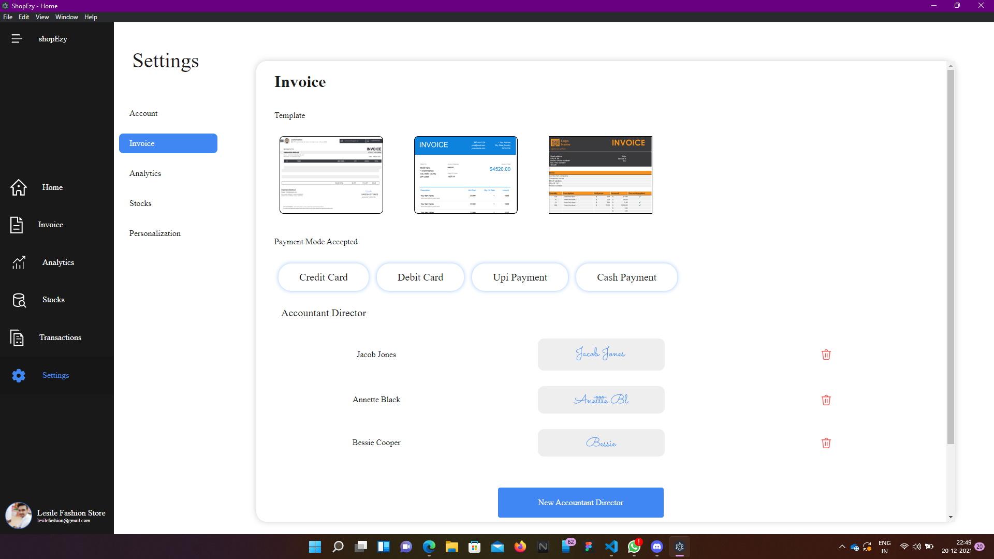

Slide 32
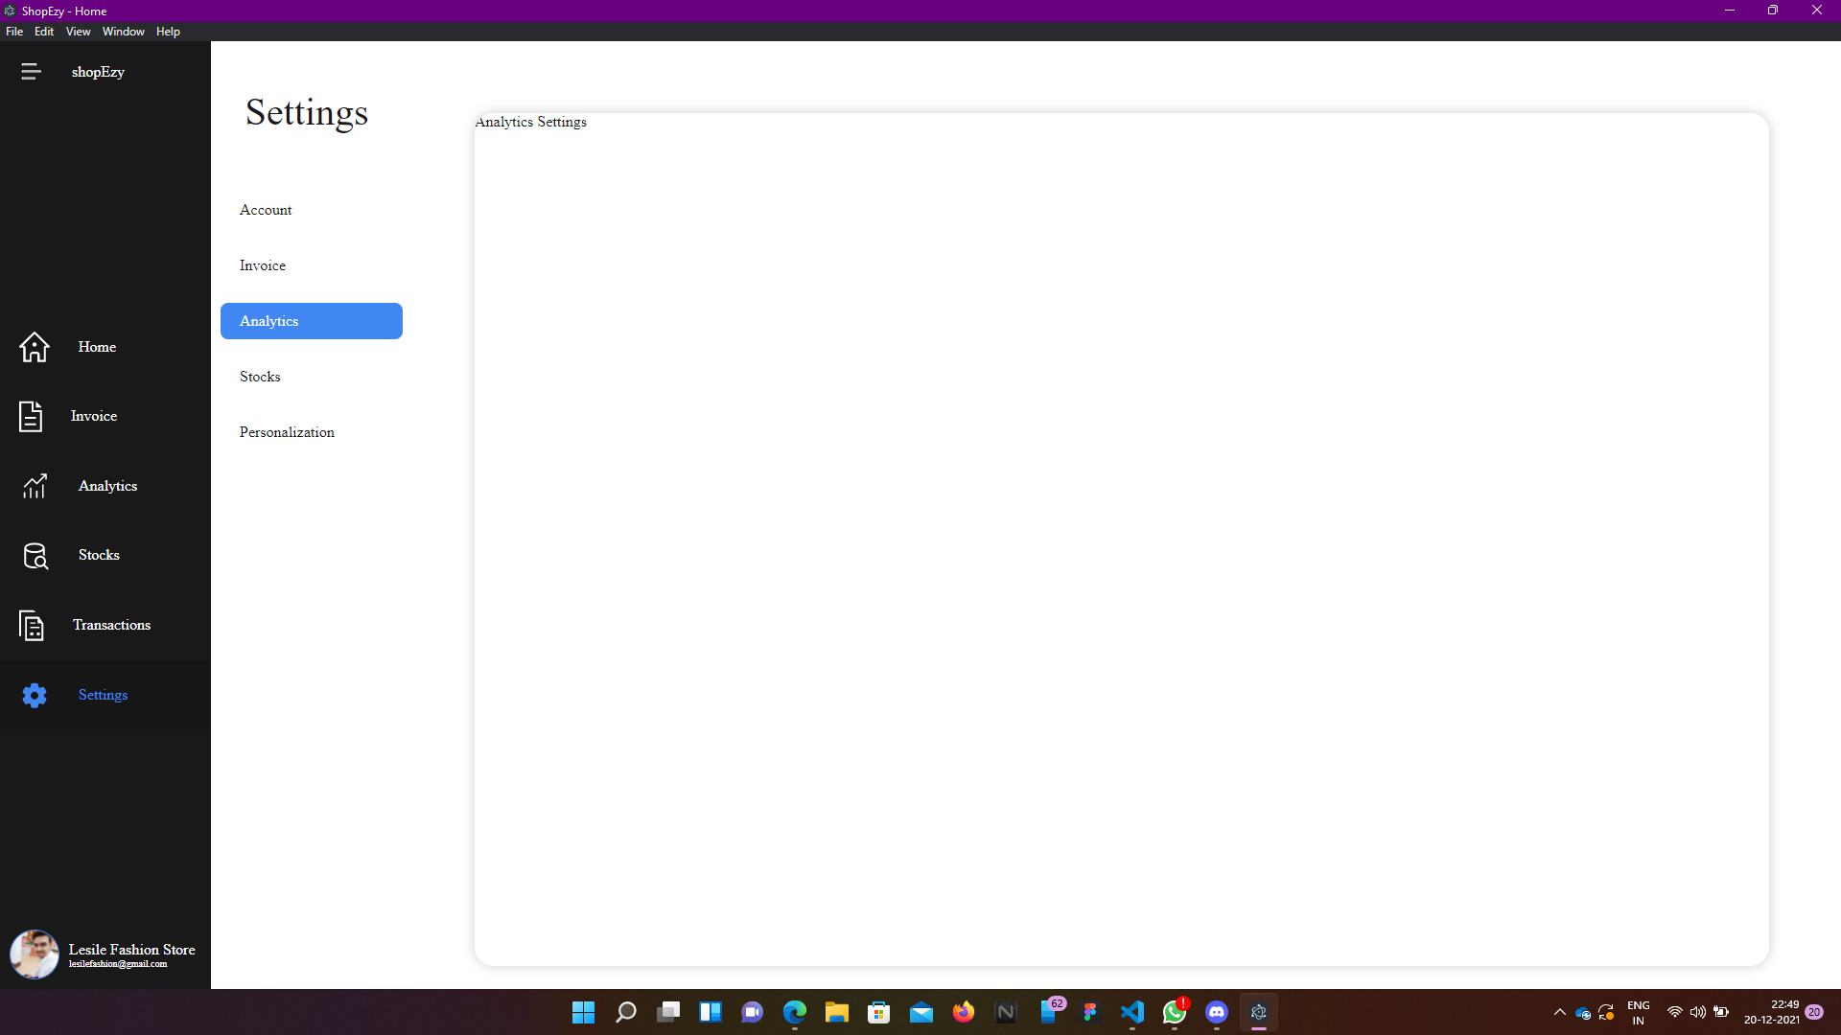

Slide 33
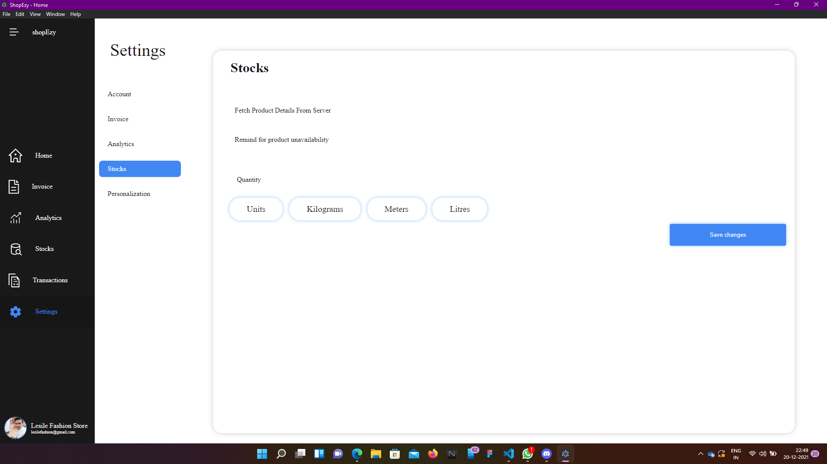

Slide 34
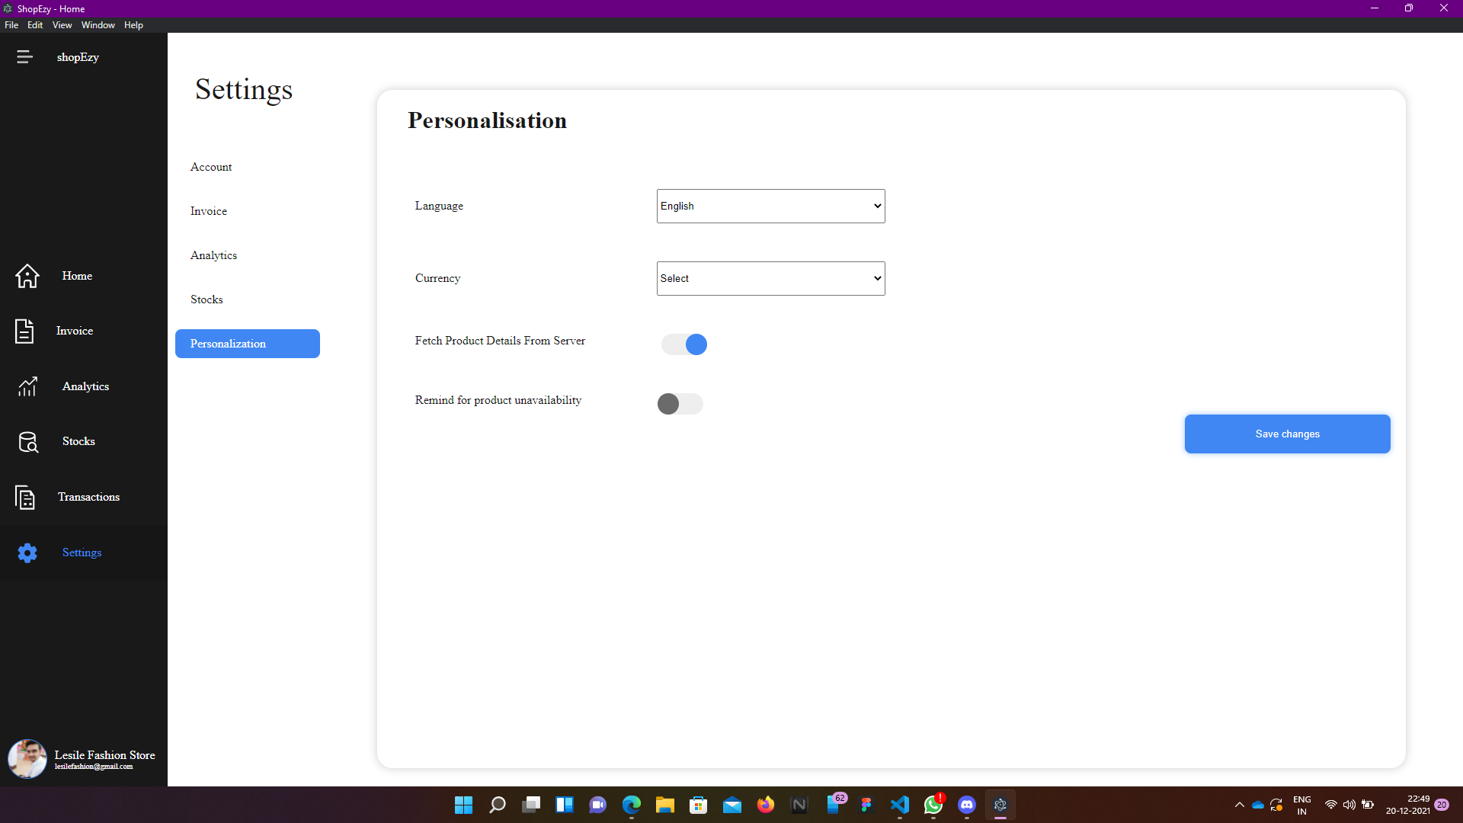

Slide 35
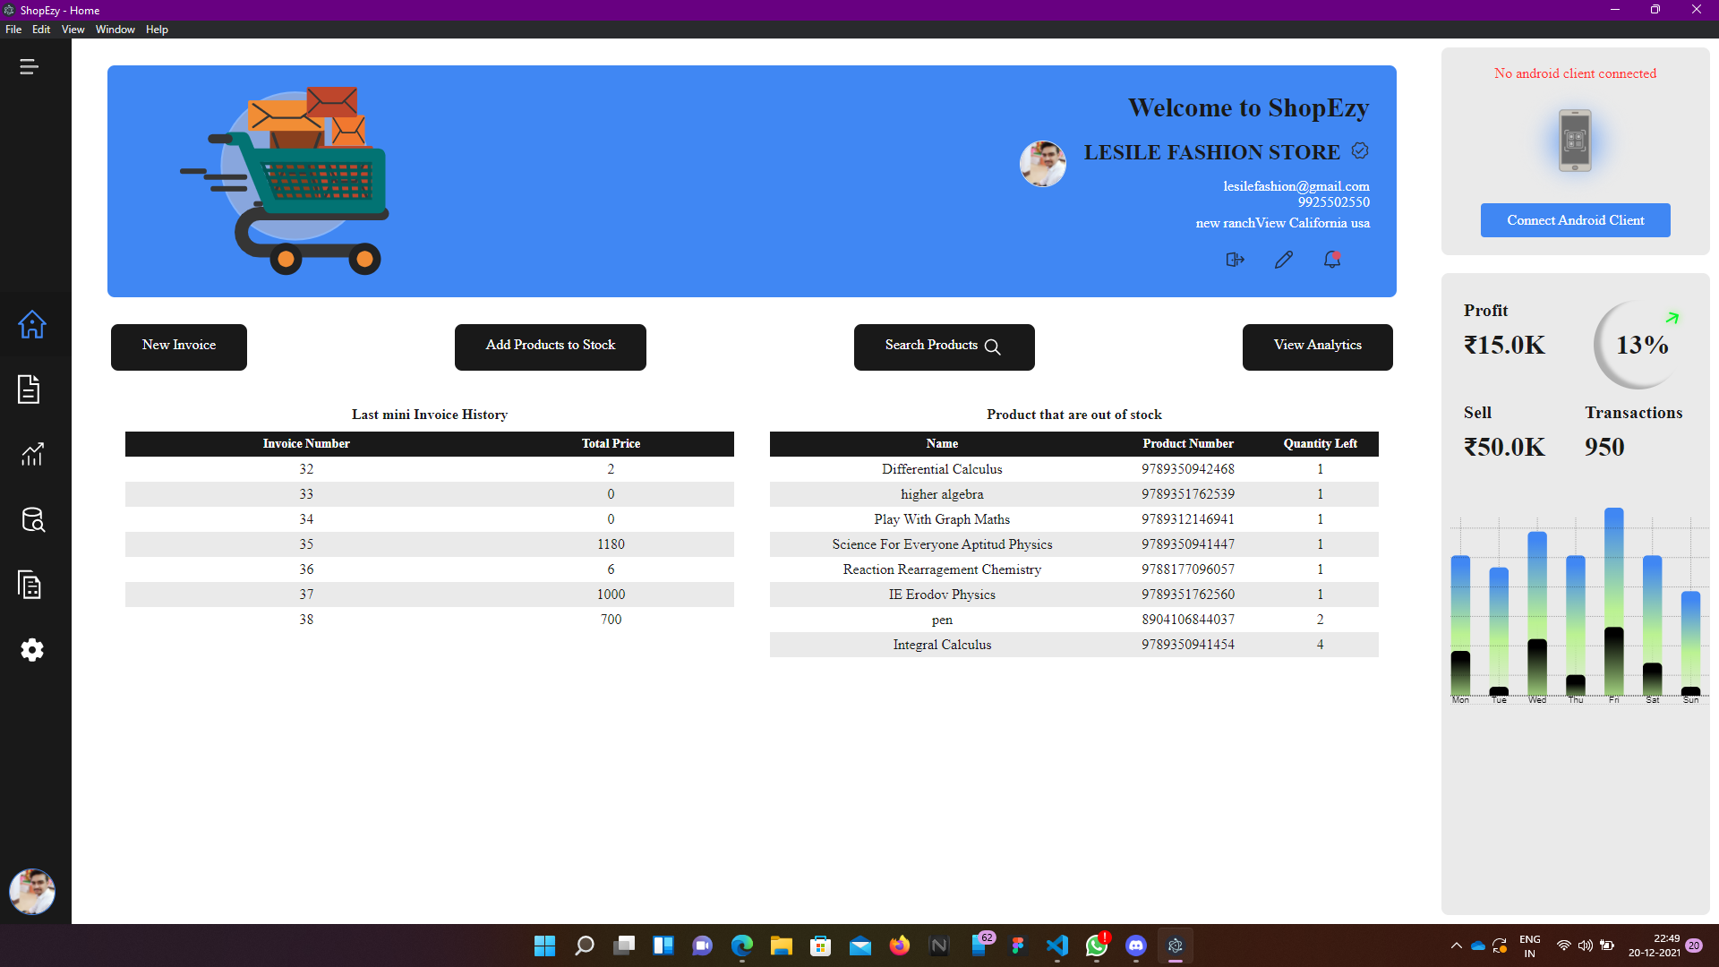

Slide 36
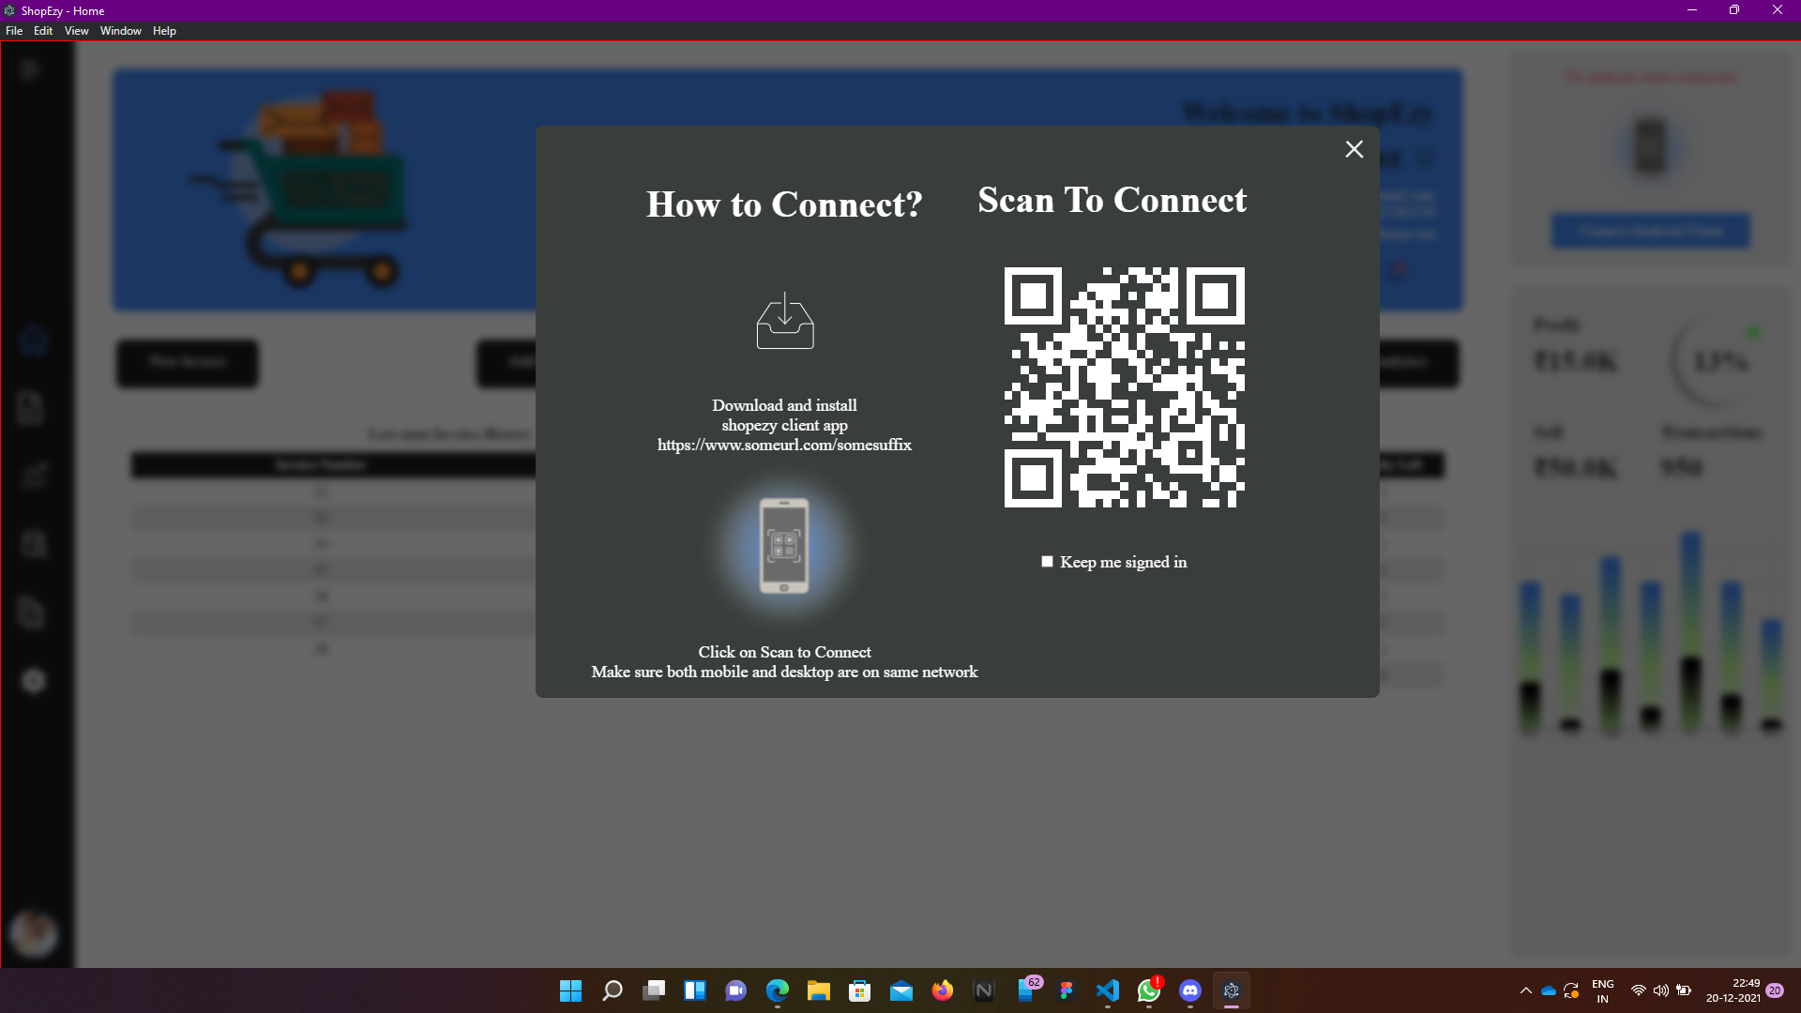

Slide 37
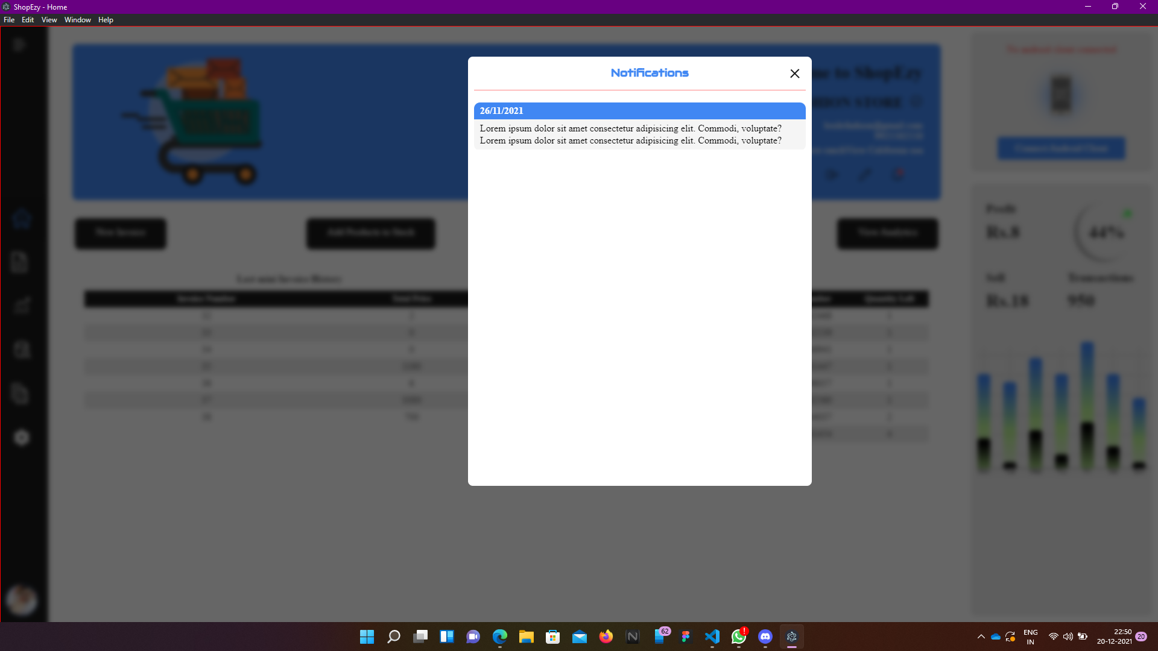

Slide 39

Thank you !

